Slide 1


Modernization Assis-tance & Real Estate Concierge​
Team 3: Hichem Ben Aoun, Kira Feinauer, Robin Gansäuer, Jonas Michel, Aleksandar Bachvarov
June 2024

Slide 2
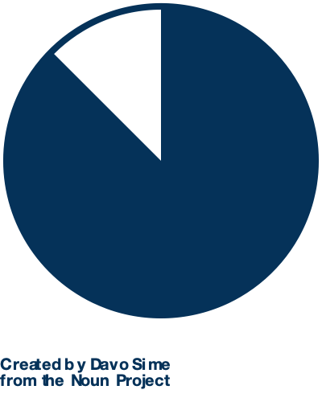
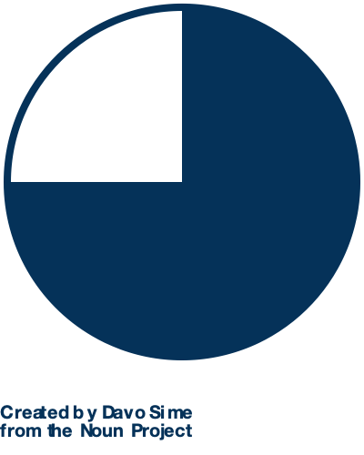
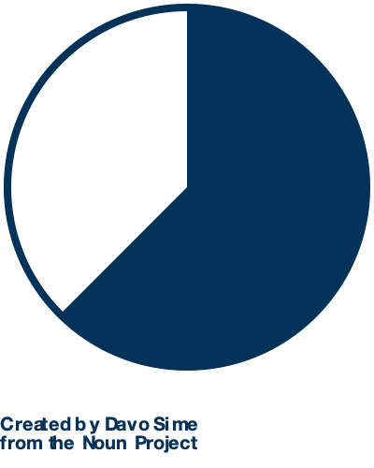
Interview Insight: 6 key drivers influence home modernization and user perception¹ to guide prototype development
Cost Savings
Political Regulation
Openness to AI Solutiuon
Mentioned by 7 out of 8 participants (88%)
Reducing expenses through effective modernization is crucial. Savings are expected through energy efficiency, reduced maintenance, and leveraging affordable modernization solutions.
Mentioned by 6 out of 8 participants (75%)
Compliance with evolving regulations is necessary, impacting planning and execution. Understanding and adapting to political guidelines influence home modernization.
General openness: 7 out of 8 participants (88%)
Scepticism towards commercial providers:
4 out of 8 participants (57%)
Users appreciate AI for simplifying processes but remain cautious about commercial AI offerings.
Planning and Execution
Practical Usage
Environmental Awareness
Bureaucratic barriers: 5 out of 8 participants (63%)
Service provider qualification: 3 out of 8 participants (38%)
Overcoming bureaucratic hurdles and ensuring qualified service providers are essential for successful modernization.
Ease of information procurement: 6 out of 8 participants (75%)
Comparison of funding options and providers:
5 out of 8 participants (63%)
Simplifying information access and comparing providers are vital for user-friendly modernization experiences.
Mentioned by 5 out of 8 participants (63%)
Environmental considerations are important. Users are motivated by sustainable practices and environmentally-friendly modernization options.
¹ Semi-structured interviews (n = 8)
Capstone Project Team 3 – Designing Interactive Systems
2
Notes:
2min

Slide 3




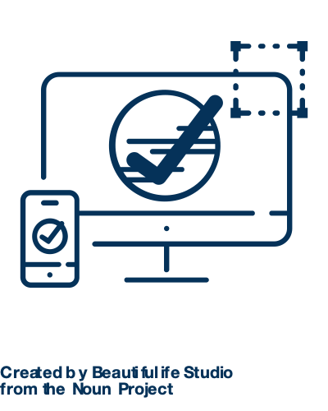
From low-fidelity to high-fidelity: A prototyping journey through two human feedback loop iterations
Low-fidelity prototype
Keep the human in the loop
Final validation of prototype
Create prototypes
Train
first bot
Human Feedback
Choose for High-fidelity
Refine
bot
Validate
High-fidelity
Finalize prototype
1
2
3
4
5
6
7
We first created seven low fidelity prototype flows based on the semi-structured interview information we gathered. Each flow represented a variation of a functionality or layout.
We trained the first iteration of the AI-Concierge Bot with ChatGPT based on multiple modernization questionnaires.
We started the human feedback loop with thinking aloud sessions with seven interviewees for both the low-fidelity prototypes and the trained bot.
Based on the feedback, we chose the most promising low-fidelity prototype and constructed the first iteration of the high-fidelity prototype.
We refined the AI-Concierge based on thinking aloud sessions, improving its conversational tone and question relevance.
We validated our high-fidelity prototype with thinking aloud sessions, cognitive walkthroughs, and heuristic evaluation.
Based on the second iteration of the human feedback loop, we finalized the high-fidelity prototype, focusing on key features, reducing clutter, emphasizing important parts, and optimizing feature positioning and navigation to help users reach their goals effectively.
Notes:
2min

Slide 4

The high-fidelity prototype has
4 key features based on user feedback
1 | MARC | How is MARC navigated? MARC is positioned as a central point of interaction at the top of every screen and can be accessed via voice or text. Automates tasks such as scheduling appointments and finding contractors. Continuously updates with changes in regulations and best practices.
2 | Project | What does the Project feature include? Offers project management tools for tracking progress and managing timelines. Provides expert recommendations for materials and design. Includes financial planning tools to help budget and manage costs.
3 | News | How does the News feature benefit the homeowner? Screens news for regulatory changes that impact home modernization. Provides updates on new technologies and materials in the market. Alerts homeowners to potential risks and necessary actions.
4 | My Home | What information is stored in My Home? Saves all relevant data related to the home and modernization projects. Stores documents such as permits, plans, and contractor information. Keeps track of maintenance schedules and history.
Notes:
2min - Jonas

Slide 5
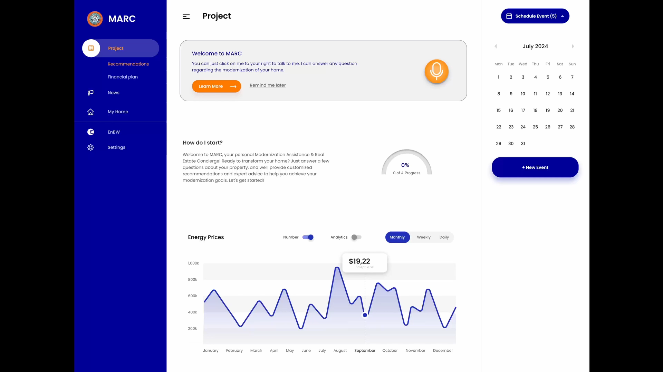
Notes:
30s-1min

Slide 6



MARC can break the modernization status quo and strategically position EnBW as an innovation leader
Modernization check
1 | Combining advantages | Integration of Services: MARC unifies the modernization check and consultations for a seamless experience. 24/7 Availability: Instant access to information and recommendations anytime. Enhanced User Experience: Supports text and speech interactions for user convenience.
2 | Benefits for EnBW | Customer Engagement: Improved user experience leads to higher customer satisfaction and retention and possibly attracts new EnBW customers. Cost Efficiency: Automation reduces the need for extensive human resources. Innovation Leadership: Positions EnBW as a forward-thinking company in the energy sector.
3 | Actions needed | Expand evaluation: Larger scale user studies to support current findings to ensure to satisfy all user needs. Keep the human in the loop over the whole further process. Development: Focus on transitioning MARC from a Figma design to a fully functional product. Marketing: Promote MARC as a central feature of EnBW’s service offerings.
Free, comprehensive analysis of modernization benefits with online forms and instant feedback.
Free consultants
Personalized advice on energy-efficient upgrades and customized solutions tailored to the property.
Currently infrequent use
Trade-off between a fast process and tailored solutions via consultation, more marketing necessary, and process might be too complex.
Notes:
1min

Slide 7
Modernization Assis-tance & Real Estate Concierge​
Team 3: Hichem Ben Aoun, Kira Feinauer, Robin Gansäuer, Jonas Michel, Aleksandar Bachvarov
June 2024

Slide 8



The market for property modernization is influenced by three key factors
Regulatory Changes
Energy Prices
Technological Advances
Inventory of central heat generators for heating in Germany by category in 2022 in millions¹
Index for the development of electricity prices for households in Germany (1998 = Index 100)²
Forecast of the number of smart home households in Germany for the years 2020 to 2028 (in millions)³
+ 270%
The Building Energy Act (GEG) mandates the transition to renewable energy sources.⁴
Electricity prices for households in Germany have more than doubled since 1998, reaching an index of 270.²
The number of smart home households in Germany is projected to grow to nearly 40 million by 2028.³
Source: Statista^{1,3}; BDH²; Bundesverband des Schornsteinfegerhandwerks²; §72 Gebäudeenergiegesetzt (GEG)⁴
Notes:
1min

Slide 9

The current state of
real estate modernization necessitates a better
approach
1 | Regulation | How to navigate the complex regulatory landscape? Navigating through various regulatory requirements can be challenging and time-consuming. Continuous updates and changes in laws necessitate ongoing monitoring and adaptation.
2 | Planning | Why is personalized planning expensive? Custom solutions tailored to individual properties require extensive analysis and bespoke design. Hiring specialized consultants and planners adds to the cost.
3 | Time | What makes modernization time-consuming? Thorough assessment and planning stages involve multiple inspections and evaluations. Obtaining necessary permits and approvals extends the timeline.
4 | Investment | What are the potential financial risks? Upfront costs are involved in modernization projects, including expenses for planning, materials, and hiring specialized professionals. Potential for sunk costs exists if the project is discontinued after initial investments, resulting in the loss the initial investment.
Notes:
2min - Jonas

Slide 10
First findings identify four key features for the AI concierge
1 | Regulation | Continuous regulatory updates needed. MARC should provide continuous updates about housing and building regulations, along with an individual assessment of the individual applicability.
2 | Planning | Provide a detailed financial planning. MARC should provide a detailed financing plan developed to assess the cost-effectiveness of implemented measures over time.
3 | Conflict of Interest | Remove energy consultant’s conflict of interest. MARC should provide product recommendations and referrals without following its own interest, ensuring that all suggestions are based purely on the user's preferences and needs.
4 | Easy access | Reduce time consumption. MARC should provide a simple access, a user-friendly interface and an effortless interaction, reducing the existing entry barrier for home modernization.
Age distribution of interview partners (n=7)¹
Types of modernization done in the last ten years (n=7)¹
¹ Further interviews scheduled
Capstone Project Team 3 – Designing Interactive Systems
10
Notes:
2min

Slide 11
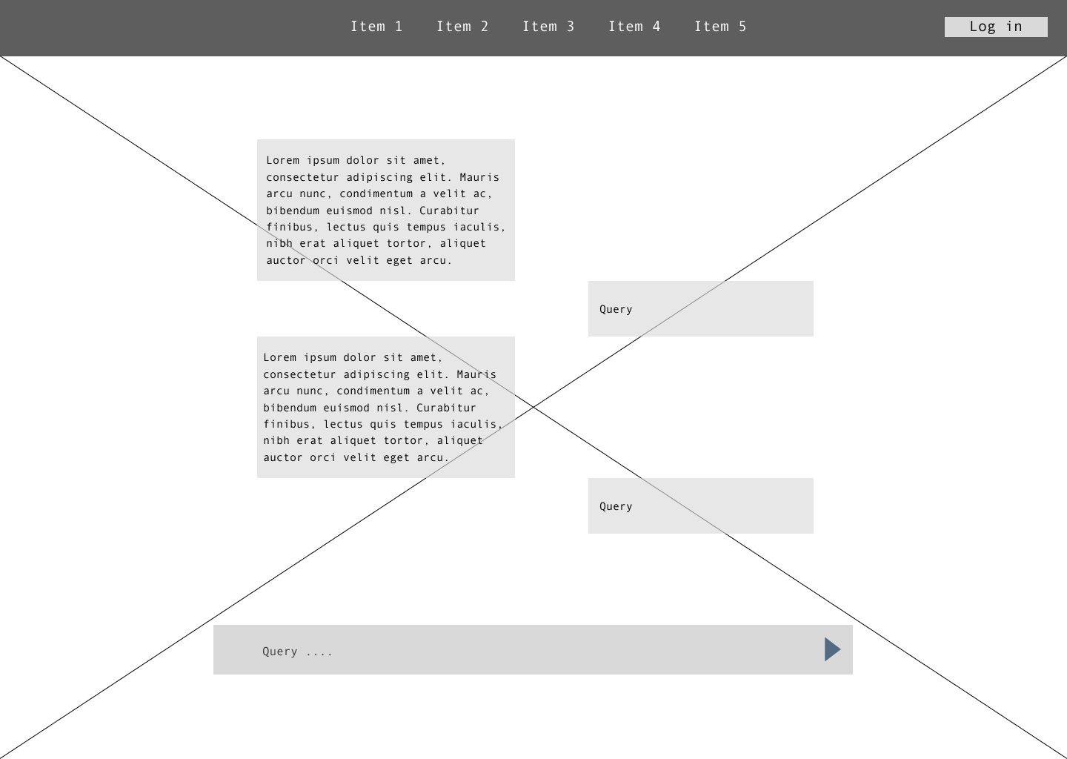
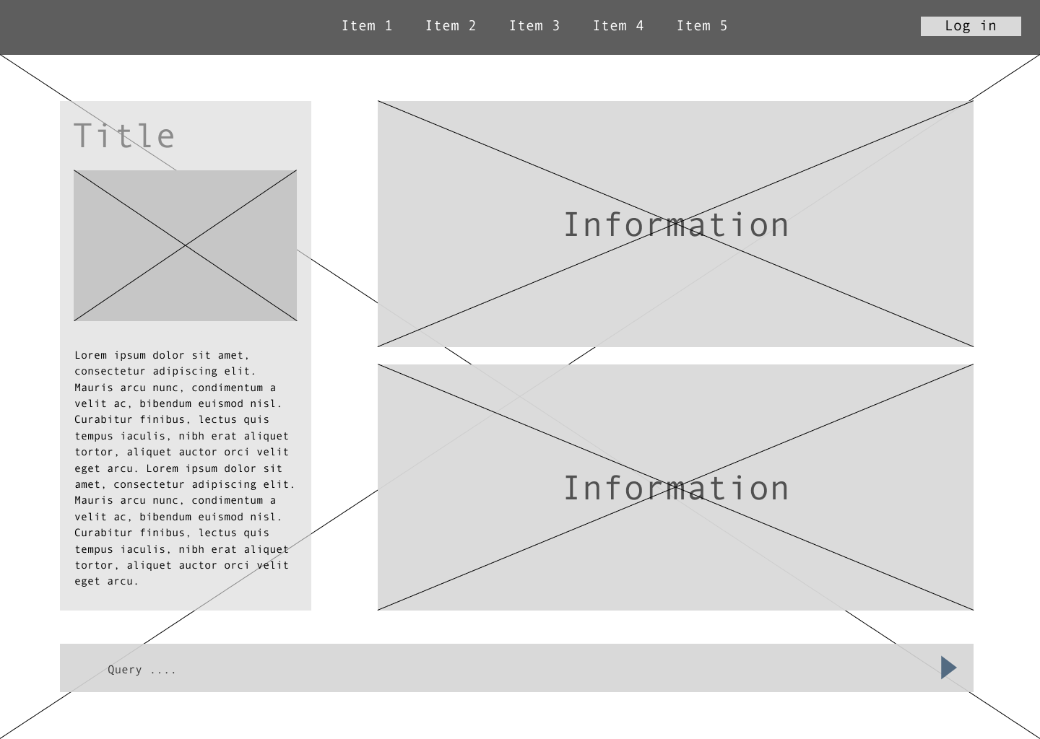
Developing an AI concierge low-fidelity prototype
Central point of information
The central point of information will serve as the primary source of relevant data for users seeking modernization insights. This section will include titles, descriptions, and detailed content to assist users in accessing the latest trends, strategies, plans, and resources for modernizing their operations efficiently.
Central point of interaction
Display relevant regulatory information in a feed-like design with applicability assessment.
MARC can answer user questions about the displayed information
The central point of interaction will be the main interface where users can engage with the AI concierge. This area is designed to be intuitive and user-friendly, ensuring easy navigation and interaction. MARC can interact with all data from this interface.
Notes:
2min

Slide 12
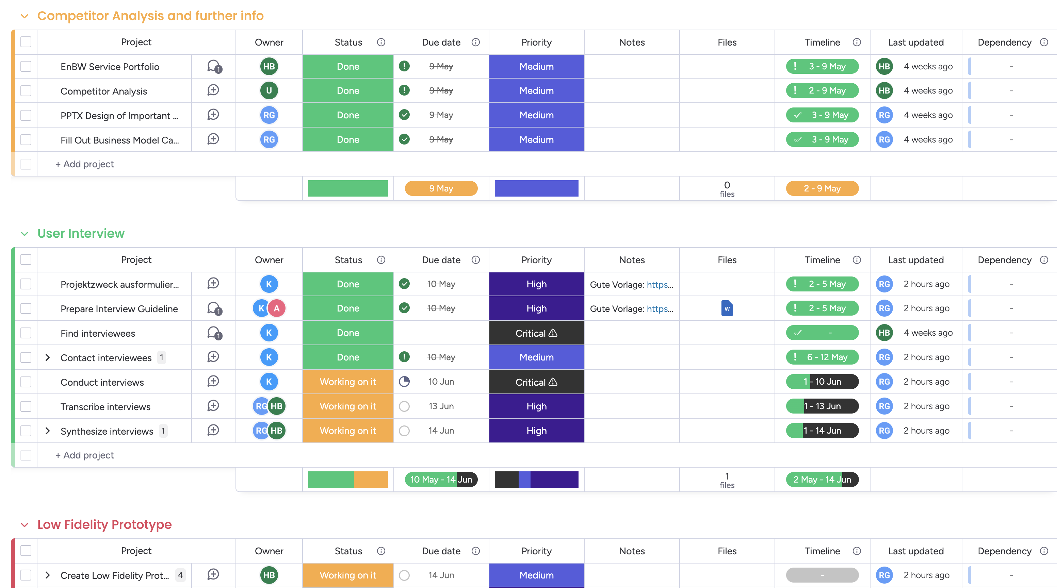





Overview of our team structure, organizational strategies, and planned next steps
Project Management Tool
Next Steps
Plan
Analyze
Evaluate
Specify
Design
Done
Analyze interviews
The analysis is scheduled to be finalized at the end of next week.
Current status
High fidelity prototype
The high-fidelity prototype is expected to be finalized on the 17th of June.
Project
structured
Conducting interviews
Designing
low-fidelity prototype
Notes:
30s-1min

